Slide 1
Architectural Modeling and Real-Time Systems
CSCE 742 - Lecture 20 and 21 -
11/20 and 27/2018

Slide 2

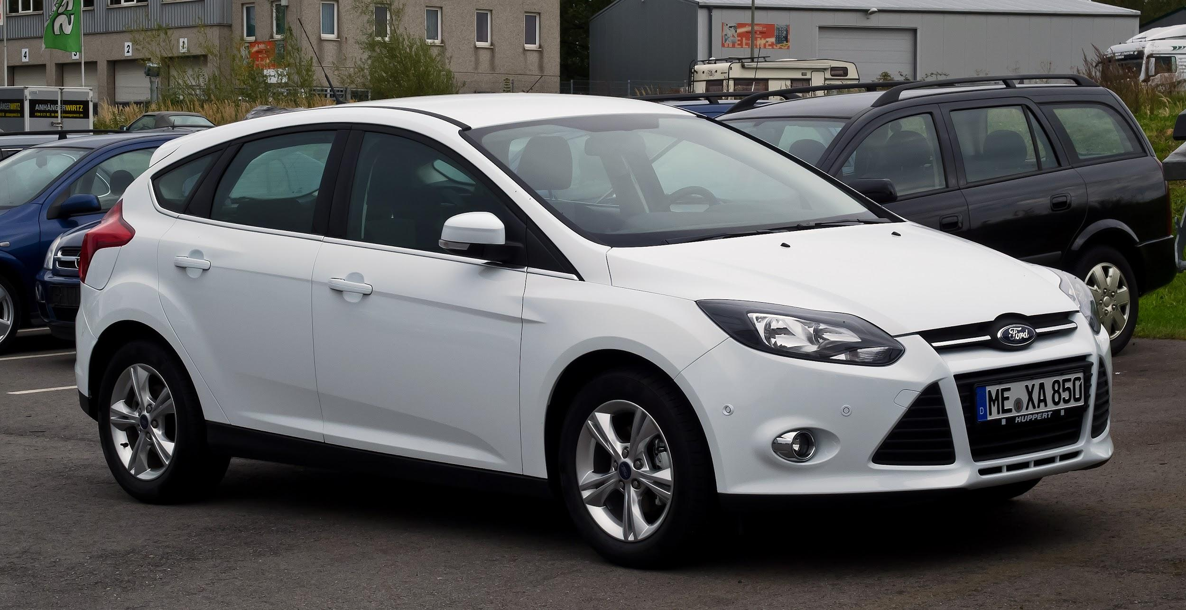

Our Society Depends on Software
This is software: So is this:
Also, this:
Notes:
Amazon, of course, is software. No one disputes that. If I ask you about software, you’d mention something like this - a web app, a video game, a word processor. That’s not all that is software though - Our society is built on software. It powers our homes, it manages our private information, it controls our cars, it automates our factories and it even regulates our bodies. Ford is one of the largest software makers in the country. It is incredibly important that we construct good software. We need robust, operational systems, especially given growing demand for features, limited development budgets and strict time constraints.

Slide 3
Real-Time Architectures
A system is real-time if “correctness” depends not only on the logical answer, but the time it was performed.
Hard or immediate real-time: The completion of an operation after the deadline is useless.
Can cause a critical failure.
Soft real-time: Some lateness is tolerated, but may cause decreased service quality.
(ex: omitting frames in a video)
Notes:
And many - maybe even most, by number - of those systems are what we refer to as real-time systems.
A system is said to be real-time if the total correctness of an operation depends not only upon its logical correctness, but also upon the time in which it is performed.
In a hard real-time or immediate real-time system, the completion of an operation after its deadline is considered useless - ultimately, this may cause a critical failure of the complete system.
A soft real-time system on the other hand will tolerate such lateness, and may respond with decreased service quality (e.g., omitting frames while displaying a video).

Slide 4

Traditional Domains of Concern

Slide 5

Recent Domains of Concern
Notes:
Stock trading and finance, backup storage and retrieval, VOIP, health monitoring and patient services - increasingly, software is expected to fit into daily processes - enabling us to do more and do things better. Many systems, even those that in the past would not be considered to have strict timing requirements, do now

Slide 6




Structure of Real-Time Systems
World
Actuators
Sensors
System (“Controller”)
Notes:
In general, when we discuss real-time systems, we are discussing a system that interacts with the real world in some way - which is, in addition to strict timing, why they are so difficult. So, there are varying levels of abstraction, but by interaction, we mean (go over).
(nuclear power example)
This same paradigm is pretty flexible. In a stock trading system, our sensors are not physical sensors in a room, but are monitors on information flow over the stock network. Out actuators are not always physical hardware, but the act of issuing output to other systems. The same ideas apply - a volatile environment that we sample from and influence in turn, a feedback cycle.

Slide 7
Key Concepts
Repeatedly sample inputs, assess system state, and generate output.
Sampling Rate: Rate at which the cycle takes place.
Goal is often to approximate continuous assessment
Sampling rate must be “fast enough”
(for good approximation)
Rate depends on speed of computations.
Notes:
Real-time systems operate in cycles. They repeatedly sample inputs, assess system state, and generate system outputs. All computation takes place in the same mode - take reading from the environment, process that reading, issue output back to the environment.
Rate at which this cycle occurs is called sampling rate or period
Often approximating continuous assessment of the environment (i.e., differential equations)
Sampling rate must be “fast enough” to provide good approximation
Sampling rate depends on the rate of change for the system

Slide 8
Key Concepts
Perform bounded amount of work per cycle.
Need to process the next sample!
Need to finish within sample time.
Longest time to process is called worst-case execution time (WCET).
End-to-end latency is also important.
System -> Actuator -> Environment -> Sensor -> System
Controller must have an accurate view of the system
Actuator must react “fast enough” to influence the environment in time.
Notes:
System should be designed to Perform bounded amount of work per cycle - you have to be done in time to process the next sample!
Which means that you Need to be able to finish within sample time
Longest time to process is called worst case execution time (WCET)
End-to-end latency is also important (system to actuator to environment to sensor back to system) - the complete cycle.
Controller must have accurate view of system
Actuators must react “fast enough” (last point)

Slide 9
Concept: Tasks
Tasks are separately scheduled units of work
AKA: Threads!
Real-time systems are split into independent, concurrent tasks.
A process describes a set of threads that share an address space.
Each thread is a “task”.
May run at different sampling rates
(measured in cycles-per-second, Hz)
Threads need to be scheduled to run on CPUs.
May need to communicate dependencies.
Notes:
Tasks are Separately scheduled units of work. This is a generic concept - this isn’t a computer term specifically, but it applies here too - sounds like a thread, right?
Often, (3) and multiple tasks are involved in a real-time system - each running concurrently, and largely independently
A process describes a set of threads that share an address space. Each thread is a task.
May run at different sampling rates Usually specified in cycles-per-second (Hertz)
Need to be scheduled to run on one or multiple CPUs Several scheduling algorithms can be used
May have communication dependencies with other tasks

Slide 10
Concept: Scheduling
Algorithms create a guaranteed schedule or abort (no schedule can guarantee schedulability of system).
RMA: Rate-Monotonic (high throughput)
DMA: Deadline-Monotonic (finish critical first)
Take as input:
Per task: period, WCET
Per processor: worst-case thread context switch, process context switch
Additional constraints and frame dependencies.
Frame dependencies = ordering constraints for tasks in a schedulable period (frame).
Notes:
Algorithms create either guaranteed schedule or abort. Abort: no schedule that will guarantee schedulability of system
Several real-time scheduling algorithms exist: RMA: Rate-monotonic analysis scheduling, DMA: Deadline-monotonic analysis
Algorithms take (as input):
Per task: period, WCET
Per processor/OS: worst case thread context switch, process context switch
Additional information (e.g. frame dependencies, soft constraints)
Frame dependencies define ordering constraints for tasks within a frame (schedulable period)

Slide 11
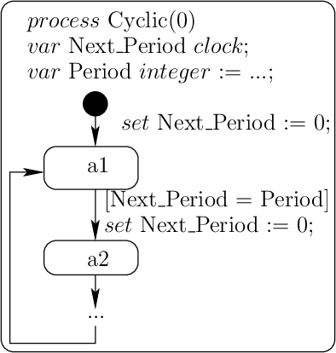
Scheduling
Most tasks are polling (cyclic).
May also have event-based tasks.
Called aperiodic tasks.
Require minimum delay between events to schedule.

Slide 12
End-to-End Latency
Data flows through controller from inputs to outputs (back to environment).
May go through several intermediate tasks.
End-to-End Latency describes the amount of time required for end-to-end flow.
Time to impact the environment and notice the change in the sensor readings.
Frame dependencies change end-to-end latency.
Mid-frame communications have less latency.
Phase-delayed communications have more.
Notes:
1-2 (in the controller - not just one task. Some tasks have a pipe and filter structure, not a direct connection to sensors)
3-6). These are tasks communications in the same frame - same scheduling period) - they can communicate based on the same data that has already come in this cycle.
(7) - these are communications that require issuing output through actuators to the environment, then taking new sensor readings.

Slide 13
Process Communication
Several mechanisms for communication between processes/threads.
Logical views:
Message queue / pipe
Rendezvous
Remote procedure call
Physical views:
Shared memory
Interrupt
Bus
Network
Notes:
Rendezvous (data synchronization mechanism - a system call that lets two processes exchange a data item over a memory address. The rendezvous call takes a tag and a value as its arguments. The tag is typically an address in memory shared by both processes. Calling rendezvous causes a process to sleep until a second rendezvous call with a matching tag occurs. Then, the values are exchanged and both processes are awakened.

Slide 14
Polling or Event-Based?
Do you ask sensors for a reading, or let sensors send you readings?
Polling… or event-based?
Current system uses polling for most tasks.
Polling processes allow simpler scheduling.
Maintains periodicity of threads to be scheduled.
However, polling can be very inefficient.
Monitoring user interface elements (key presses).
Polling rate must be high (no missed state changes).
Also want high rate to reduce latency.
But most of the time, it does nothing.
But…events can cause missed deadlines.

Slide 15
Architecture Challenges
Scheduling tasks is extremely hard.
Some tasks need to run more often than others, but have worse WCET.
Task A may need to run more often than task B, but can’t preempt task B.
Do you poll sensors or wait for events?
Algorithms must be fast!
Hardware can be noisy or fail.
Environmental input can fail to arrive as expected (too fast or too slow).

Slide 16
How do we design an architecture for this?
Notes:
(discussion) Point is - there are a lot of different answers to this question

Slide 17
Architectural Modeling
Notes:
(discussion) Point is - there are a lot of different answers to this question

Slide 18
Many Errors Stem from Architecture Issues
Global variable used in different functions:
Issues: inconsistent values, concurrent accesses
Cause: Architecture Design (use of encapsulation)
Use of COTS elements without validation:
Impact: do not fit with the environment, crash
Cause: No Validation of Components Integration
Timing issues
Impact: deadlines not enforced, bad values
Cause: poor integration policy, lack of analysis
These errors could be detected during design, but are detected instead during integration - incurring major cost!
Notes:
(title)
And also where-- what kind of error we find-- during the development process? What kind of error are we finding during the integration? First of all, many global variables and we have many different interactions. And for example, we have inconsistent values, concurrent accesses and what you call race-condition. Also we reuse components; and sometimes the reuse quality is not so good and we have some inconsistency when we integrate them We also have timing issues; for example, the deadlines are not enforced, the worst-case execution time sometimes is wrong and so on.So we have a lot of issues we discover lately
Fact number one is that all these errors can be detected at design time. And fact number two: Actually we detect these errors during integration. And fact number three: They incur a lot of rework costs and engineering work. So we need to address these issues early in the development process; not during integration.

Slide 19
Architecture Description Languages
Language for viewing and analyzing “architectural” software concerns.
Describes structure of system rather than (functional) implementation.
Subject of much research in late 1990s and early 2000s.
Many academic ADLs
…and of course, UML
Wide range of ADLs for different kinds of software
Today: AADL (Architectural Analysis & Design Language) is one of the most common.
Notes:
(title), or ADLs, offer (1), Loosely defined, “an ADL for software applications focuses on the high-level structure of the overall application rather than the implementation details of any specific source module”. (rest)

Slide 20
Architecture Description Languages
ADLs ≈ Multi-model architecture notations
Overview paper: “A classification and comparison framework for Architecture Description Languages” by Medvidovic and Taylor
http://citeseerx.ist.psu.edu/viewdoc/download?doi=10.1.1.151.4061&rep=rep1&type=pdf
We have seen one (UML) in some depth already in the viewpoints.
Doesn’t have (agreed upon) semantics, though.
Difficult to use for analysis and architecture generation - more for human consumption.
Notes:
To support architecture-based development, formal modeling notations and analysis and development tools that operate on architectural specifications are needed. Architecture description languages (ADLs) and their accompanying toolsets have been proposed as the answer (1) - languages for describing and more importantly, analyzing architectures. If you want to learn more - there’s a good paper that I’ve linked here and on the site.
Now, we’ve basically seen (4). It’s kind of a poor choice, however - (5-6). It’s basically only fit for human consumption - as a visual aid. It is useless for automated purposes, as it is very free form, and lacks strict rules.

Slide 21
Why use ADLs?
Help us understand the architecture.
Designed for analysis and reasoning to draw conclusions about the performance of the model.
Designed to ensure consistency between different system views.
Often designed to generate system skeleton.
Medium of communication.
Reduce the amount of information the reader needs to understand, and should structure the information.
Help organize processes, teams, and deliverables.
ADs can be built directly from ADLs.
Notes:
So, why use ADLs then? (1-5) in a “good” way, (6) based on the structures revealed in the model. (7)

Slide 22
Two Architecture World Views
Bottom up (assembly):
Architecture description is assembled from viewpoints that describe different facets of architecture.
Top down (generative):
Architecture specification (in ADL) is used to generate different viewpoints (via extraction) to present information of interest to stakeholders.
Can also generate implementation skeletons.
Notes:
Fundamentlaly, there are two world views to the construction of architecture. From the bottom up - what we’ve already covered. (1-2). The other way around is (3-5). Now, we’ve focused on the bottom-up for good reason: separation of concerns. However, in this situation, care must be taken to avoid contradictory views. The other way around is sometimes favored, as you can focus on the bit picture and then drill into details - but you must not get overwhelemed for forget anything. In some situations, you may want to apply both approaches - start in one, shift to the other.

Slide 23
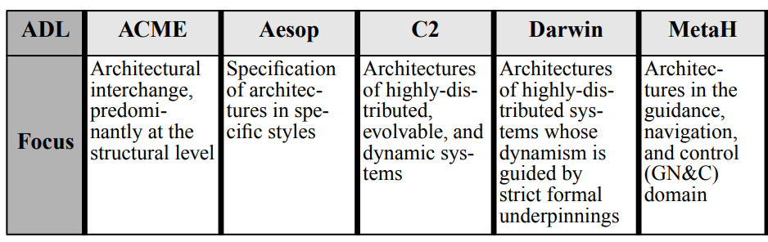
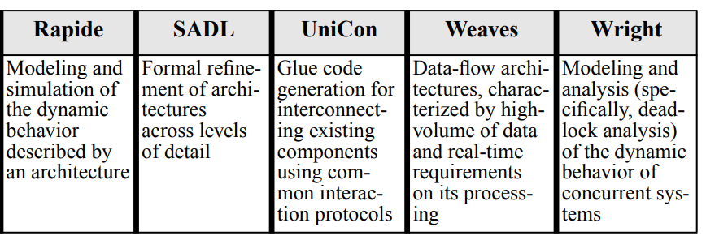
Language Focus and Applications
Notes:
There are a ton of languages, here are features of a few. Later today, we’ll dive into AADL, which is focused on embedded systems but fairly widely applicable.

Slide 24
ADL Features
An ADL must provide the means to model:
Elements and their interfaces.
Interfaces are essential for demonstrating underlying semantics of the model.
Connectors.
Architectural configurations/topologies.
ADLs often have tool support for:
Showing individual views.
Performing automated verification of properties or other analyses.
Performing model refinement.
Implementation generation.
Notes:
The building blocks of an architectural description are (1) components, (2) connectors, and (3) architectural configurations. An ADL must provide the means for their explicit specification; this enables us to determine whether or not a particular notation is an ADL. In order to infer any kind of information about an architecture, at a minimum, interfaces of constituent elements must also be modeled. Without this information, an architectural description becomes but a collection of (interconnected) identifiers, similar to a “boxes and lines” diagram with no explicit underlying semantics. Several other aspects of elements, connectors, and configurations are desirable, but not essential: their benefits have been acknowledged and possibly demonstrated in the context of a problem domain or a style, but their absence does not mean that a given language is not an ADL.
an accompanying toolset will render an ADL both more usable and useful - rest

Slide 25
Support for Modeling Elements
Interface:
A element’s interface is a set of interaction points between it and the external world.
Specifies services and constraints on their usage.
Types:
Element types are abstractions that encapsulate functionality into reusable blocks.
Elements can be instantiated multiple times.
Semantics:
High-level model of an element’s behavior.
Needed to perform analysis, enforce constraints, ensure consistent mapping between abstractions.
Notes:
(1) The interface specifies the services (messages, operations, and variables) a component provides. In order to support reasoning about a component and the architecture that includes it, An interface thus defines computational commitments a component can make and constraints on its usage
(3) A component type can be instantiated multiple times in a single architecture or it may be reused across architectures. Component types can be parameterized, further facilitating reuse.
(5) Such a model is needed to perform analysis, enforce architectural constraints, and ensure consistent mappings of architectures from one level of abstraction to another. Note that a component’s interface also allows a certain, limited degree of reasoning about its semantics. However, the notion of semantics used in this paper refers strictly to models of component behavior.

Slide 26
Support for Modeling Elements
Constraints:
A property of or assertion about a system or one of its parts, where a violation will reduce value.
Constraints needed to verify adherence to uses, enforce boundaries, and establish dependencies.
Evolution:
The modification of (a subset of) a element’s properties, e.g., interface, behavior, or implementation.
Non-Functional Properties:
Properties that affect safety, security, performance, portability.
Notes:
(1-2) the violation of which will render the system unacceptable (or less desirable) to one or more stakeholders [9]. In order to ensure adherence to intended component uses, enforce usage boundaries, and establish dependencies among internal parts of a component, constraints on them must be specified.
4) — As architectural building blocks, components will continuously evolve. Component evolution can be informally defined as the modification of (a subset of) a component’s properties, e.g., interface, behavior, or implementation. ADLs can ensure that evolution happens in a systematic manner, by employing techniques such as subtyping of component types and refinement of component features.
(6) A component’s non-functional properties (e.g., safety, security, performance, portability) typically cannot be directly derived from the specification of its behavior. Early specification of such properties (at the architectural level) is needed to enable simulation of runtime behavior, perform analysis, enforce constraints, map component implementations to processors, and aid in project management.

Slide 27
Support for Modeling Connectors
Interface
A set of interaction points between the connector and the attached elements and other connectors.
Enable connectivity of elements and their interaction
Types
Abstractions of element communication, coordination, and mediation decisions.
Makes coordination protocols reusable within and across architectures.
Semantics
High-level model of a connector’s behavior.
Enables element interaction analysis.
Notes:
Connectors are architectural building blocks used to model interactions among components and rules that govern those interactions. Unlike components, connectors may not correspond to compilation units in an implemented system. They may be implemented as separately compilable message routing devices, but may also manifest themselves as shared variables, table entries, buffers, instructions to a linker, dynamic data structures, sequences of procedure calls embedded in code, initialization parameters, client-server protocols, pipes, SQL links between a database and an application, and so forth. The features characterizing connectors are their interfaces, types, semantics, constraints, evolution, and non-functional properties
(1) Interface — A connector’s interface is a set of interaction points between the connector and the components and other connectors attached to it. Since a connector does not perform any application-specific computations, it exports as its interface those services it expects of its attached components. Connector interfaces enable proper connectivity of components and their interaction in an architecture and, thereby, reasoning about architectural configurations.
(4) — Connector types are abstractions that encapsulate component communication, coordination, and mediation decisions. Architecture-level interactions may be characterized by complex protocols. Making these protocols reusable both within and across architectures requires that ADLs model connectors as types. This is typically done in two ways: as extensible type systems, defined in terms of interaction protocols, or as built-in, enumerated types, based on particular implementation mechanisms.
(7) Similarly to components, connector semantics is defined as a high-level model of a connector’s behavior. Unlike components, whose semantics express application-level functionality, connector semantics entail specifications of (computationindependent) interaction protocols. ADLs may support modeling of connector semantics in order to enable component interaction analysis, consistent refinement of architectures across levels of abstraction, and enforcement of interconnection and communication constraints

Slide 28
Support for Modeling Connectors
Constraints
Ensure adherence to intended interaction protocols, establish intra-connector dependencies, and enforce usage boundaries.
I.e., limit on number of elements that use connector.
Evolution
The modification of (a subset of) its properties, e.g., interface, semantics, or constraints on the two.
Non-Functional Properties
Properties that represent (additional) requirements for correct connector implementation.
Notes:
(1) Connector constraints ensure adherence to intended interaction protocols, establish intra-connector dependencies, and enforce usage boundaries. An example of a simple and easily enforceable constraint is a restriction on the number of components that interact through the connector. Establishing adherence to more complex connector constraints (e.g., minimal throughput) may require access to information external to the given connector (e.g., a model of the attached components’ dynamic semantics).
(4) — Analogously to component evolution, the evolution of a connector is defined as the modification of (a subset of) its properties, e.g., interface, semantics, or constraints on the two. Component interactions in architectures are governed by complex and potentially changing and expanding protocols. Furthermore, both individual components and their configurations evolve. ADLs can accommodate this evolution by modifying or refining existing connectors with techniques such as incremental information filtering, subtyping, and refinement
(6) A connector’s non-functional properties are not entirely derivable from the specification of its semantics. They represent (additional) requirements for correct connector implementation. Modeling non-functional properties of connectors enables simulation of runtime behavior, analysis of connectors, constraint enforcement, and selection of appropriate off-the-shelf (OTS) connectors (e.g., message buses) and their mappings to processors.t.

Slide 29
Support for Modeling Configurations
Connected graphs of elements and connectors that describe structure.
Needed to determine whether appropriate elements are connected, that their interfaces match, that connectors enable communication, and that combined semantics are correct.
Modeling enables assessment of concurrent/distributed behavior.
Deadlock/starvation, performance, reliability, security
Enable analysis of architectures for adherence to design rules.
Too many direct communication links harm evolution
Notes:
Architectural configurations, or topologies, are connected graphs of components and connectors that describe architectural structure. This information is needed to determine whether appropriate components are connected, their interfaces match, connectors enable proper communication, and their combined semantics result in desired behavior.
In concert with models of components and connectors, descriptions of configurations enable assessment of concurrent and distributed aspects of an architecture, e.g., potential for deadlocks and starvation, performance, reliability, security, and so on.
Descriptions of configurations also enable analyses of architectures for adherence to design heuristics (e.g., direct communication links between components hamper evolvability of an architecture) and architectural style constraints (e.g., direct communication links between components are disallowed).

Slide 30
Support for Modeling Configurations
Understandable Specifications
Model structural (topological) information with simple and understandable syntax. System structure should be clear from the configuration.
Compositionality
A mechanism that allows architectures to describe software systems at different levels of detail.
Can show complex information in detail, or abstract it into a subelement that is modeled elsewhere.
Refinement and Traceability
Enable correct and consistent refinement of architectures into executable systems and traceability of changes across levels of refinement.
Notes:
Understandable Specifications — One role of software architecture is to serve as an early communication conduit for different stakeholders in a project and facilitate understanding of (families of) systems at a high level of abstraction. ADLs must thus model structural (topological) information with simple and understandable syntax. The structure of a system should ideally be clear from a configuration specification alone, i.e., without having to study component and connector specifications.
Compositionality — Compositionality, or hierarchical composition, is a mechanism that allows architectures to describe software systems at different levels of detail: complex structure and behavior may be explicitly represented or they may be abstracted away into a single component or connector. Situations may also arise in which an entire architecture becomes a single component in another, larger architecture. Such abstraction mechanisms should be provided as part of an ADLs modeling capabilities.
Refinement and Traceability — In addition to providing architects with semantically elaborate facilities for specifying architectures, ADLs must also enable correct and consistent refinement of architectures into executable systems and traceability of changes across levels of architectural refinement. This view is supported by the prevailing argument for developing and using ADLs: they are necessary to bridge the gap between informal, “boxes and lines” diagrams and programming languages, which are deemed too low-level for application design activities.

Slide 31
Support for Modeling Configurations
Heterogeneity
Facilitate development of large-scale systems.
Pre-existing elementsand connectors of varying granularity
Different formal modeling languages and programming languages
Varying operating system requirements
Different communication protocols
Scalability
Provide developers with abstractions needed to cope with the issues of complexity and size.
Evolvability
Incremental addition, removal, replacement, and reconnection in a configuration.
Notes:
Heterogeneity — A goal of software architectures is to facilitate development of large-scale systems, preferably with pre-existing components and connectors of varying granularity, possibly specified in different formal modeling languages and implemented in different programming languages, with varying operating system requirements, and supporting different communication protocols. It is therefore important that ADLs be open, i.e., that they provide facilities for architectural specification and development with heterogeneous components and connectors.
Scalability — Architectures are intended to provide developers with abstractions needed to cope with the issues of software complexity and size. ADLs must therefore directly support specification and development of large-scale systems that are likely to grow further.
Evolvability — New software systems rarely provide entirely unprecedented functionality, but are rather “variations on a theme.” An architecture evolves to reflect and enable evolution of a family of software systems. Since evolution (i.e., maintenance) is the single costliest software development activity [18], system evolvability becomes a key aspect of architecture-based development. ADLs need to augment evolution support at the level of components and connectors with features for their incre-mental addition, removal, replacement, and reconnection in a configuration

Slide 32
Support for Modeling Configurations
Dynamism
Modifying the architecture and enacting those modifications while the system is executing.
Constraints
Depict dependencies in a configuration complement those specific to individual elements and connectors.
Non-Functional Properties
Used to select appropriate elements and connectors, perform analysis, enforce constraints, map architectural building blocks to processors, and aid in project management.
Notes:
Dynamism — Evolution, as we define it, refers to “off-line” changes to an architecture (and the resulting system). Dynamism, on the other hand, refers to modifying the architecture and enacting those modifications in the system while the system is executing. Support for dynamism is important in the case of certain safety- and mission-critical systems, such as air traffic control, telephone switching, and high availability public information systems. Shutting down and restarting such systems for upgrades may incur unacceptable delays, increased cost, and risk [52]. To support architecture-based run-time evolution, ADLs need to provide specific features for modeling dynamic changes and techniques for effecting them in the running system.
Constraints — Constraints that depict dependencies in a configuration complement those specific to individual components and connectors. Many global constraints are derived from or directly depend upon local constraints. For example, constraints on valid configurations may be expressed as interaction constraints among constituent components and connectors, which in turn are expressed through their interfaces and protocols; performance of a system described by a configuration will depend upon the performance of each individual architectural element; safety of an architecture is a function of the safety of its constituents.
Non-Functional Properties — Certain non-functional properties are system-level, rather than individual component or connector properties. Configuration-level non-functional properties are needed to select appropriate components and connectors, perform analysis, enforce constraints, map architectural building blocks to processors, and aid in project management

Slide 33
Architecture Analysis and Description Language (AADL)
Notes:
(discussion) Point is - there are a lot of different answers to this question

Slide 34
What is AADL?
Architecture modeling language, developed for the embedded system communities.
Uses component-based notation for the specification of task and communication architectures of real-time systems.
Offers tool-based analysis in Eclipse framework (OSATE).
Notes:
(1) - avionics, aerospace, automotive, and robotics

Slide 35
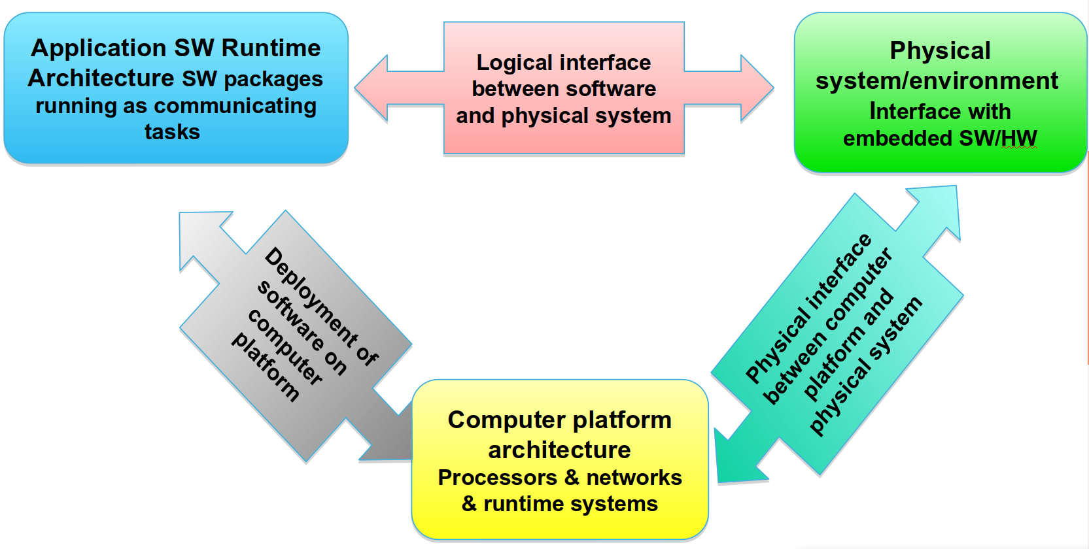
Embedded Architecture
Notes:
(go over)
AADL supports the representation of all of these levels of architecture in the same model.

Slide 36
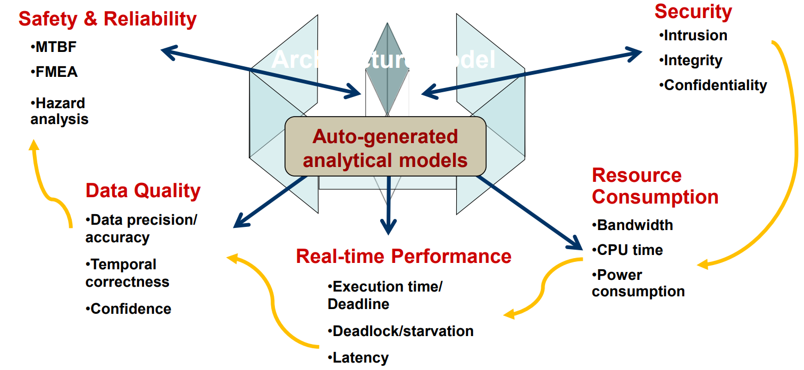
Analysis Support
Reduced model validation cost due to single source model.
AADL offers an estensible domain model with strong semantics and an XML-based interchange format.

Slide 37
The AADL Language
Precise execution semantics for components
Thread, process, data, subprogram, system, processor, memory, bus, device, virtual processor, virtual bus.
Continuous control/event processing
Data and event flow, synchronous call/return, shared access.
End-to-End flow specifications.
Operational modes/fault tolerant configs.
Modes & mode transition
Modeling of large-scale systems
Component variants, layered system modeling, packaging, abstract, prototype, parameterized templates, arrays of components and connection patterns.
Notes:
(bus transfers information between elements)

Slide 38
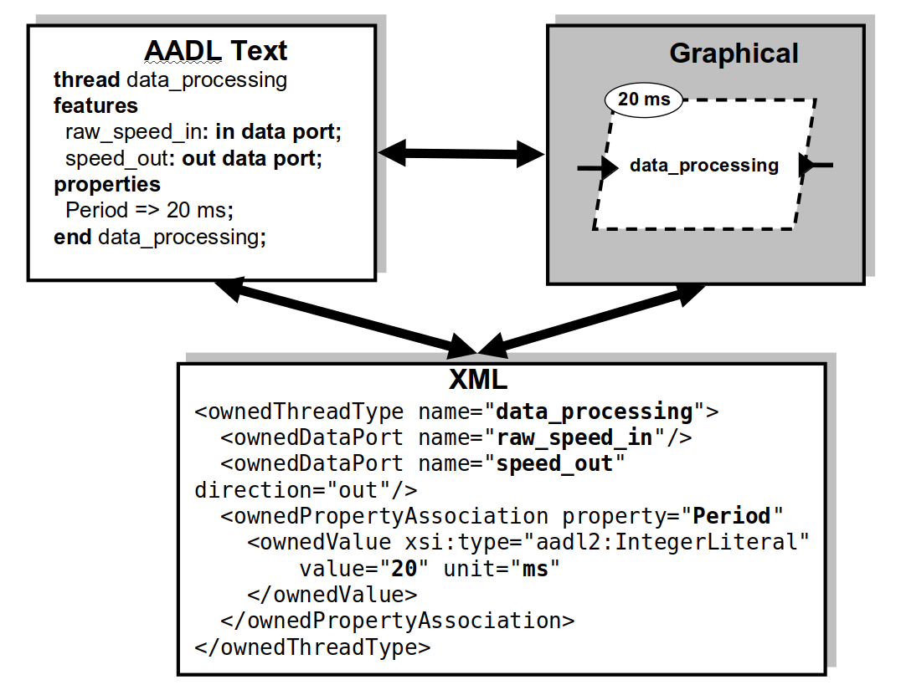
AADL Representation Forms
Notes:
ALlows you to specify models in three ways - text, graphical, or in XML (go over)

Slide 39
Component-Based Representation
Specifies a well-formed interface.
Component type allow for multiple implementations with extensions.
All external interaction points defined as features.
Data and event flows through component, across multiple components.
Properties to specify component characteristics.
Components organized into a hierarchy.
Component interaction declarations must follow system hierarchy.
Notes:
Primary concepts - components, flows, and properties.

Slide 40
Basic System Properties
AADL defines standard properties for systems, including:
System startup:
Startup_Deadline => 0.5s
A property of type Time, assigned (=>) a value of 0.5 seconds.
Value is a floating point number with a time unit.
Time units include ps, ns, ms, s, m, h, d.
Time to load all programs and data into the system:
Load_Time => 0.1s..0.15s
Two values indicate a time interval (between 0.1 to 0.25 sec)
Load_Deadline => 0.2s
Notes:
Emphasize importance

Slide 41
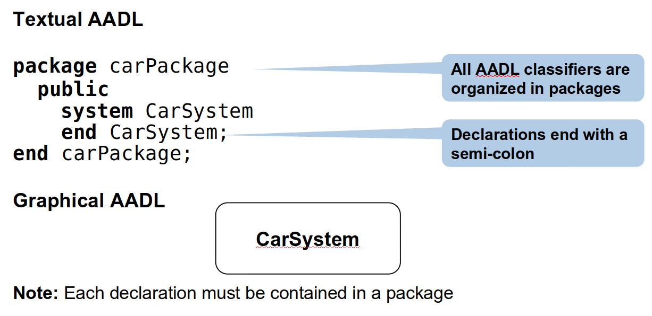
Example System: Car
Notes:
Throughout this module we create a model of a part of an automotive system to describe data flow and analyze correctness of data types. We start with a top-level system type for the car system

Slide 42
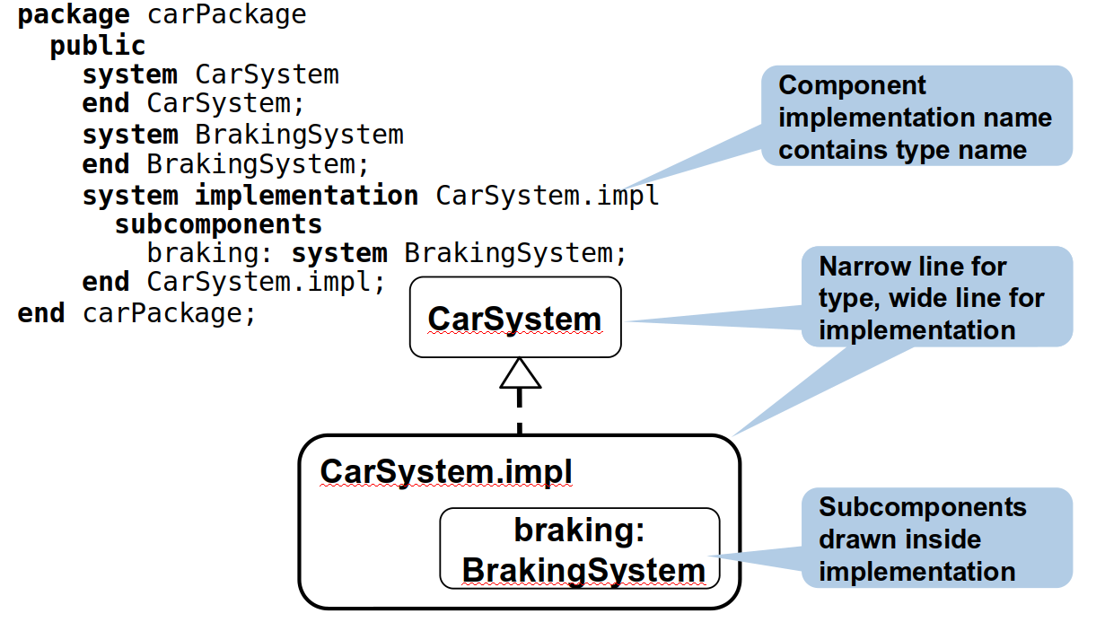
Example: Car with Braking Subsystem
Notes:
We now add a subsystem that handles braking (go over, point out implementation - CarSystem.impl is a type.

Slide 43
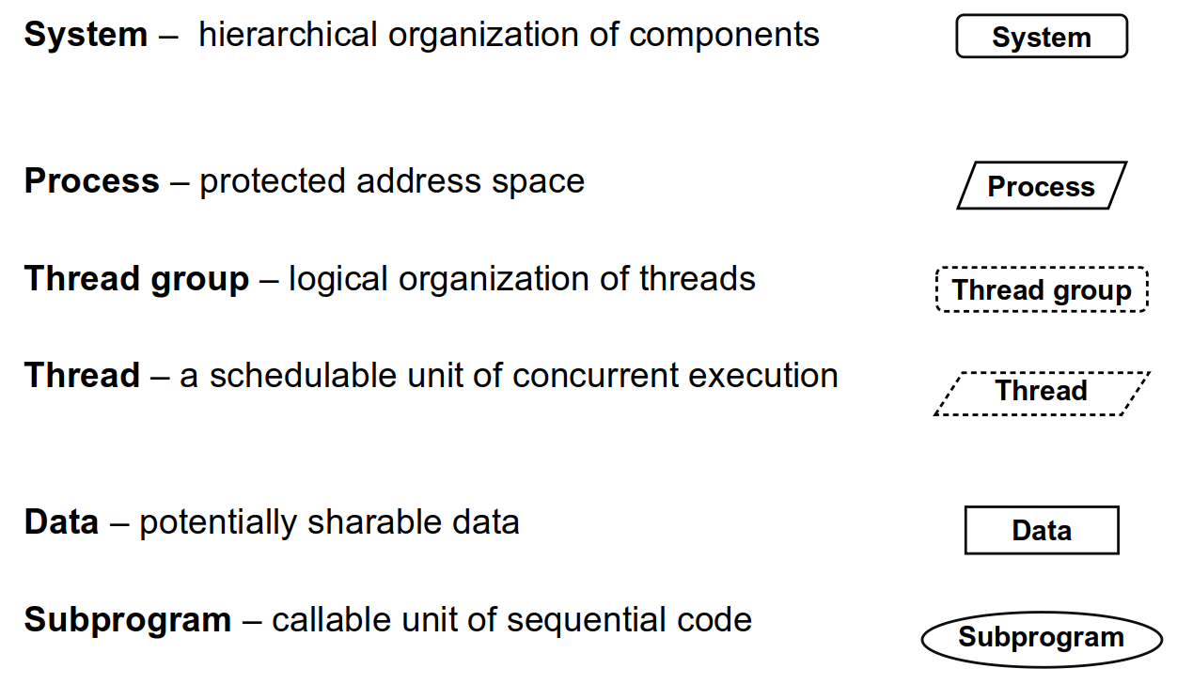
Architecture Software Components
Notes:
We can model different types of components - both SW and HW. Here are the SW components. We’ll go over examples of each.

Slide 44
Process Components
Processes represent protected virtual address spaces.
Address space boundaries are enforced at run-time.
A property setting allows to disable the protection.
Contains executable and data needed for execution and must be loaded into memory.
Process is stored in ROM
Process is loaded at system startup
Process may be unloaded when it is not active
A process must contain at least one thread subcomponent to be executable.

Slide 45
Process Properties
Process at run-time
Runtime_Protection => false;
No runtime enforcement of space protection.
Load_Time => 150ms..300ms;
Time to load image into memory.
Load_Deadline => 500ms;
Startup_Execution_Time => 100ms..110ms
Time to start process after loading (to create threads).
Startup_Deadline => 200ms;
Relationship to implementation in a programming language
Source_Language => “C”;
Source_Text => “navigation.c”;

Slide 46
Thread Components
Represents a schedulable and executable entity in a system.
Concurrent and Active tasks.
Threads execute based on time or thread-external events.
Periodically every 50ms, e.g., a data sampling thread in a control system.
Process a message upon arrival with arbitrary arrival pattern, e.g., a thread in a camera processing image data when the shutter button is pressed.

Slide 47
Thread Components
Threads are mapped onto operating system threads for execution.
One or more application threads per OS thread.
Interacts with other threads through port connections, subprogram calls, and shared data access.
Executes within the virtual address space of its enclosing process.

Slide 48
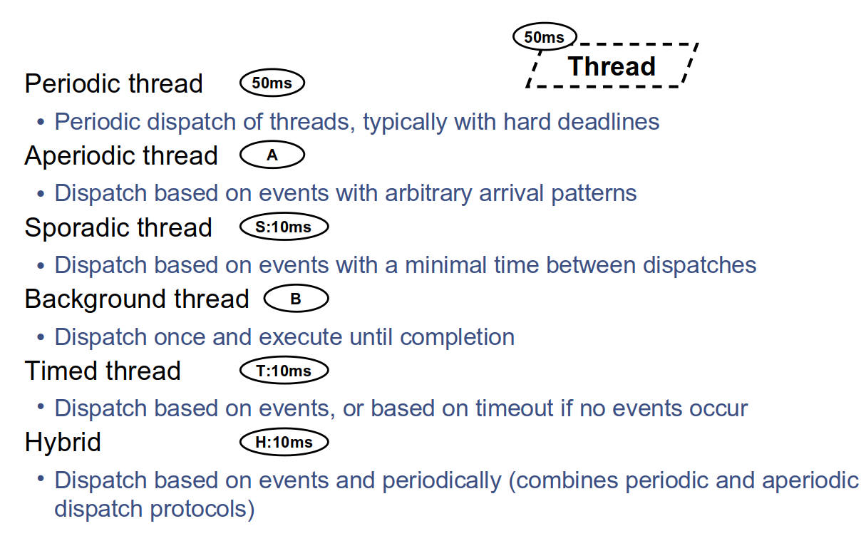
Thread Dispatch Protocols
Notes:
Dispatch protocols - when does a thread activate, when is it created, when is it destroyed?
Can also be user defined

Slide 49
Thread Properties
Properties related to thread dispatch
Dispatch_Protocol => periodic;
Any from previous slide.
Period => 50ms;
Required for periodic, sporadic, timed, hybrid threads.
Properties needed for thread scheduling
Compute_Execution_Time => 45ms..50ms;
Execution time range of thread (upper is worst-case).
Optional, defaults to period.
Deadline => 40ms;
For periodic threads: indicate delayed dispatch relative to other periodic threads.
Dispatch_Offset => 5ms;

Slide 50
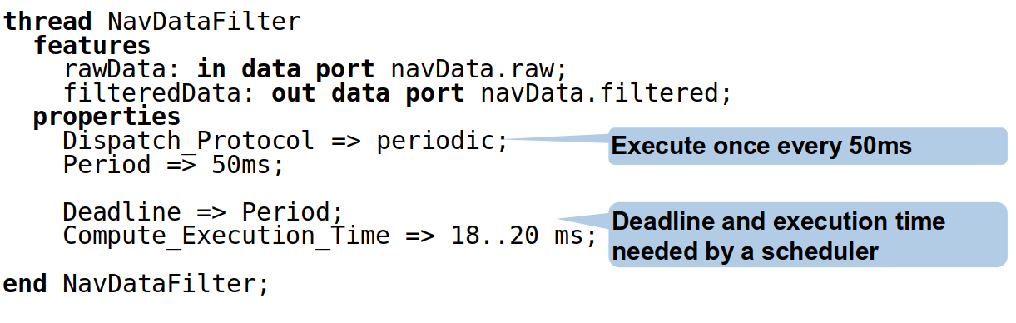
Thread Example: GPS Data Filtering
Notes:
A thread executes periodically to filter navigation data, e.g., from a GPS device

Slide 51
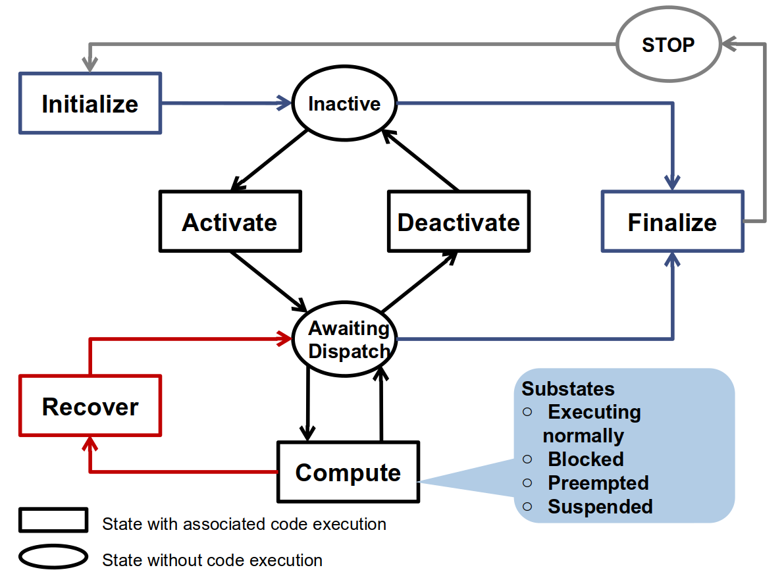
Thread States
Notes:
Threads are inherently stateful (go over)

Slide 52
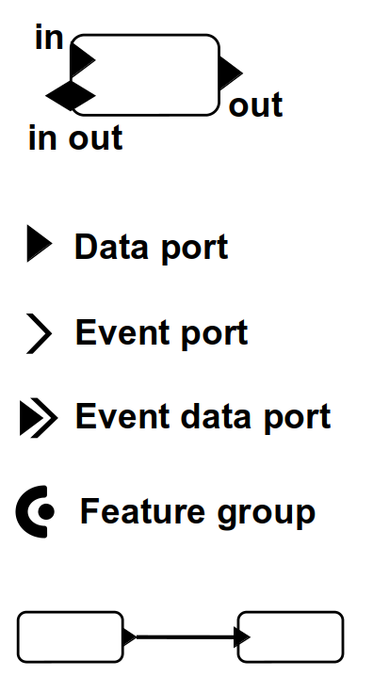
Ports and Connectors
Ports: interaction points
Model transfer of data and control.
Ports are declared as features in component types.
Data port: non-queued data.
Event port: queued signals.
Event data port: queued messages.
Feature group: aggregates ports into a single connection point.
Connections: connect ports in the direction of data/control flow.
uni- or bi-directional.

Slide 53
Port Properties
Queuing of events and messages
Required_Connection => true;
Default: no connection needed.
Queue_Size => 3;
Queue_Processing_Protocol => FIFO;
Handling of incoming event and message queues.
Overflow_Handling_Protocol => DropOldest;
Dequeue_Protocol => AllItems;
Urgency => 255;
To resolve conflicts if queues are not empty.

Slide 54
Port Properties
Frequency of data input and output
Input_Rate => (Value_Range => 1.0 .. 1.0; Rate_Unit => PerDispatch; Rate_Distribution => Fixed;)
Output_Rate
Mapping to variable in an implementation
Source_Name => "brake_state";

Slide 55
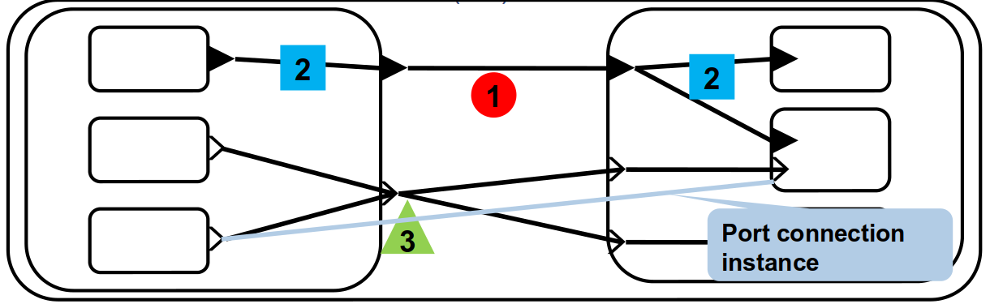
Connections Between Ports
An AADL port connection connects:
Two ports of subcomponents in the same component implementation (1).
Communication inside a component – identical port directions.
A port of a component implementation with a port of one of its subcomponents (2).
Communication with the outside – complementary port directions
A port can have multiple outgoing connections (fan-out) (3).
Data ports can have one, other ports can have multiple incoming connections (fan-in).
Connections can be bi-directional (<->).

Slide 56
Data Components
Data components can represent:
Data shared between threads or subprograms.
Local data in a thread or subprogram.
Type of data exchanged through data/event ports.
The type of subprogram parameters.
AADL models should contain information about data that is relevant to analyses of the architecture:
Bandwidth analysis – size of data elements, frequency of data exchanges.
Model consistency – size, value ranges, and physical units of exchanged data.
Notes:
Note: Use of data components is optional in an architecture May be needed for analyses or code generation

Slide 57
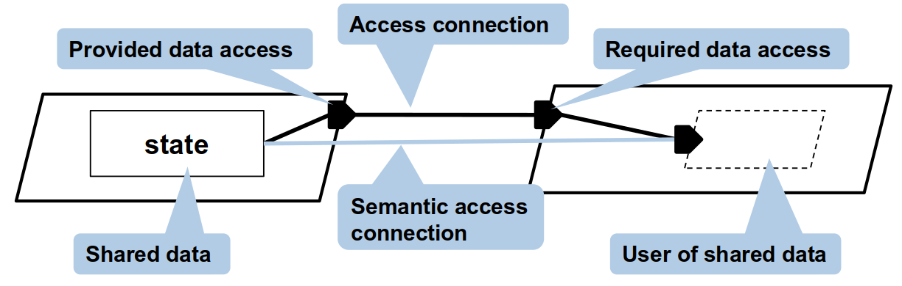
Shared Data Access
A data component can be shared among components.
Data access features: model required or provided access to a shared data component.
Access connections: model access paths to the shared data component.
Data ports must have same type, implementations of data must be identical.
Notes:
Note:
The data access symbol points away from the shared component. Data flow is indicated by the connection direction.
Where possible use port connections to express intended data flow.
Default consistency rules for port connections:
Data ports must have the same data type (if specified at both ends)
Data implementations must be identical (if specified at both ends)
Data implementation at the source end must implement the data type at the destination end

Slide 58
Flows
Model logical flow of data and control through a sequence of components and connections.
Support analysis of data flow and control flow.
Provide the capability of specifying end-to-end flows to support analyses:
End-to-end timing and latency.
Fault propagation.
Resource management based on operational flows.
Security based on information flows.

Slide 59
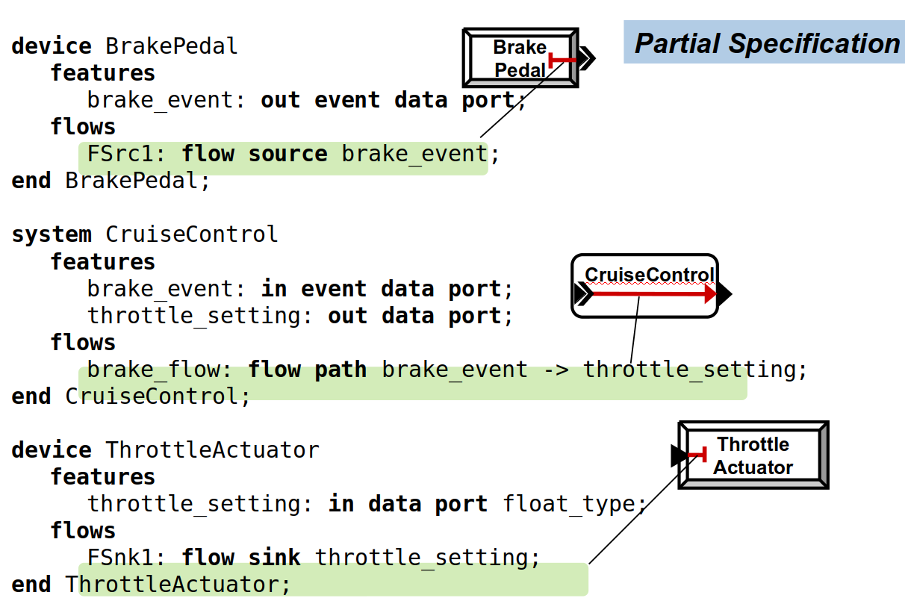
Flow Sources, Paths, Sinks
Notes:
Sources (output - starting point), sinks (input - end point), path in between
Per-component level (go over)
Describe using flows category (path from input to output)

Slide 60
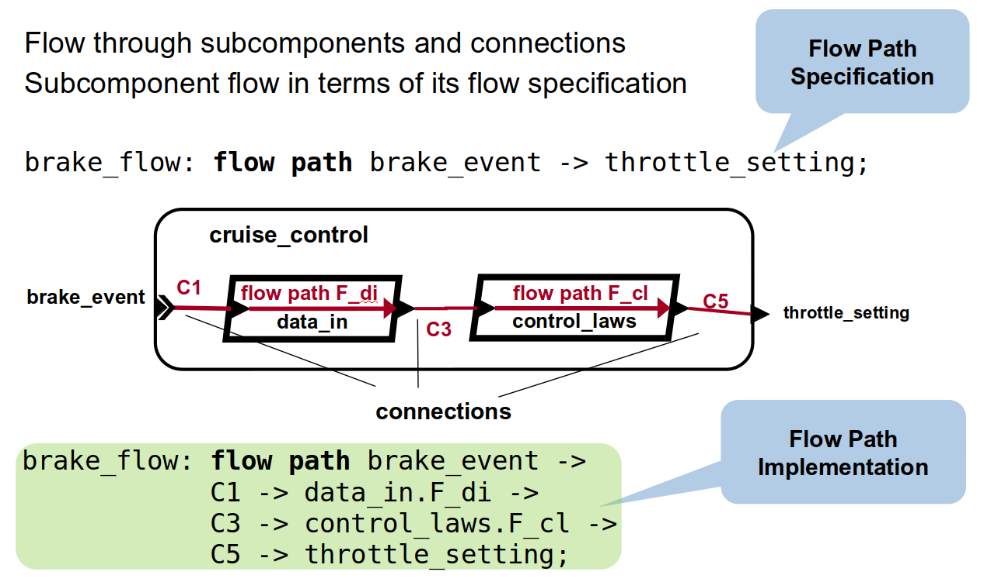
Flow Implementation
Notes:
Difference between specification/implementation
In terms of data

Slide 61
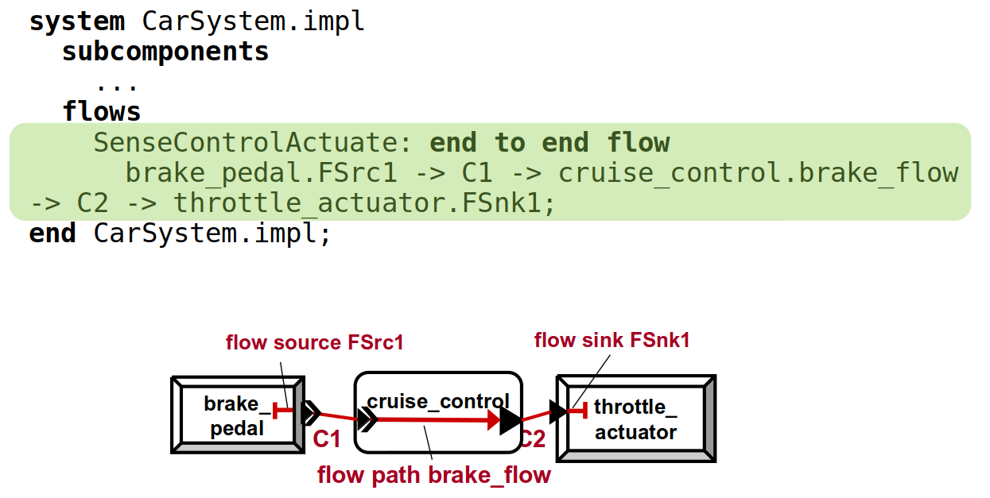
End to End Flow Example
Notes:
Now, we can specify the flow in terms of our actual subsystems - an end-to-end flow in our car example from the braking system to the cruise control system to the throttle system (go over)

Slide 62
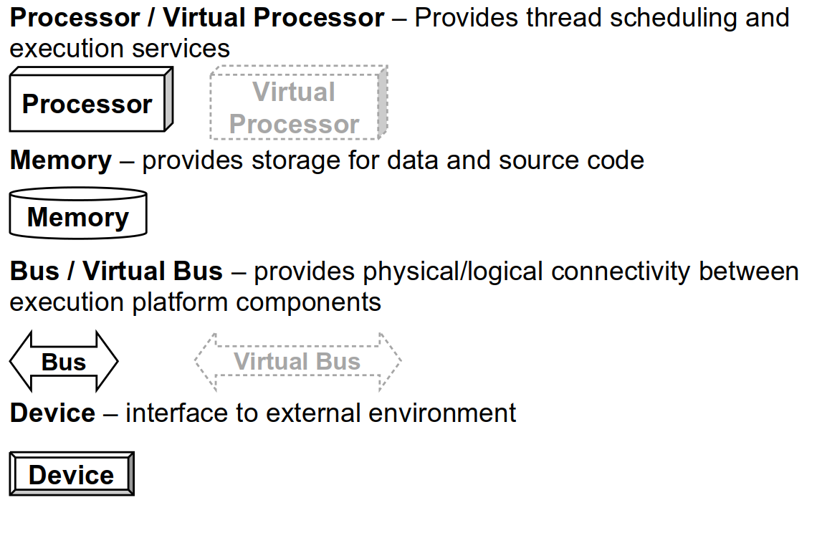
Execution Platform Components
Notes:
Hardware side

Slide 63
Execution Platform Components
Represent hardware components:
Processor timing, hardware clock period/jitter
Bus transmission time, latency
Memory capacity, access time, RAM/ROM
Represent logical resources:
Thread scheduling policy of a processor.
Communication protocol over a network connection.
Transactional characteristics of a database modeled as a memory component.
Virtual bus/processor represent only logical aspects.
These two aspects reflected in properties applied to the components.

Slide 64
Processor Components
As a hardware component:
Processors include a CPU, memory, bus, a hardware clock that can interrupt the processor
Have a MIPS rating, size, weight
As a logical resource:
Processors schedule threads
Processors execute software to provide scheduling and other runtime system functionality.
Threads are bound to processors
Processors may access memory and device components via buses, execute software associated with devices.
Notes:
(6) Implement one or more scheduling policies Clock interrupt to drive periodic dispatching

Slide 65
Processor Properties
Logical Resource (Thread Scheduling)
Scheduling_Protocol => RMS;
Thread_Swap_Execution_Time => 1.0ms;
Cost of context switching
Thread_Limit => 16;
Allowed_Dispatch_Protocol => periodic;
Source_Text => “Linux-rt.c”;
File containing the runtime system.
Hardware Component (Clock Properties)
Clock_Period => 10ms;
Time between two interrupts.
Clock_Jitter => 2ms;
Difference between interrupt handling start in multicore system.
Notes:
(2) Rate-monotonic fixed priority preemptive scheduling

Slide 66
Bus Components
As a hardware component:
A bus provides the physical connection between hardware components.
Inside a hardware component, e.g., PCI bus in a PC.
Between hardware components, e.g., a USB connection between a PC and a camera.
As a logical resource:
A bus represents the protocol(s) by which connected components communicate.
Components are connected to a bus with a bus access connection.
A bus is shared by all components that access it.

Slide 67
Bus Properties
Logical Resource
Constraints on transported content
Allowed_Connection_Type => (Port_Connection, Data_Access_Connection);
What can be transmitted over the bus?
Allowed_Message_Size => 0B..1KB;
Protocols and protocol properties
Provided_Connection_Quality_of_Service => (OrderedDelivery);
Supported protocols and QoS

Slide 68
Bus Properties
Hardware Component
Constraints on physical connectivity
Allowed_Physical_Access => (processor, memory);
What may be connected to the bus.
Properties related to data transmission time
Transmission_Time
Latency

Slide 69
Memory Components
Represent randomly accessible physical storage (e.g. RAM, ROM).
May also be used to model complex permanent storage (e.g. disks, database).
Processes must be in memory at startup to be executed.
Stored permanently in ROM, loaded into RAM.
Processors need access to memory.
Processor and memory connected via a shared bus.
Memory is contained in the processor.

Slide 70
Bringing Software and Execution Platform Together
Software relies on computational resources for execution of threads and communication among threads/between threads and devices.
In a model, software and execution platform often form independent system hierarchies.
AADL provides binding properties to describe how software components are allocated to the execution platform.

Slide 71
Binding Properties
Map software elements to platform elements using binding properties:
Actual_Processor_Binding
Specify which processor schedules and executes a thread or executes a device driver.
Actual_Memory_Binding
Specify the memory components in which executable code (process components) and data (data component) reside.
Actual_Connection_Binding
Specify the communication channels that are used by logical connections.
Notes:
Software: Components (process, thread, data), Ports (data port, event port), Connections. Execution platform: Components (processor, memory, device), Communication (bus)

Slide 72
Open OSATE Framework
Go over Toy Example
Look at both textual and graphical representation.

Slide 73
Compositional Verification Using AGREE
Notes:
(discussion) Point is - there are a lot of different answers to this question

Slide 74
Compositional Verification
Complex systems are usually designed as a hierarchical federation of elements.
As we descend the hierarchy, the design of some level becomes the requirements of elements at the next level of abstraction.
We need to verify requirements and architectural design.
What can we assume about an element’s input?
What do we guarantee about an element’s output?
Do these assumptions and guarantees hold throughout the hierarchy?
Notes:
The main idea is that complex systems are likely to be designed as a hierarchical federation of systems. As we descend the hierarchy, design information at some level turns into requirements for subsystems at the next lower level of abstraction. These hierarchical levels can be straightforwardly expressed in AADL. What we would like to support, therefore, is: an approach to requirements validation, architectural design, and architectural verification that uses the requirements to drive the architectural decomposition and the architecture to iteratively validate the requirements, and an approach to verify and validate components prior to building code-level implementations. (last three points)

Slide 75
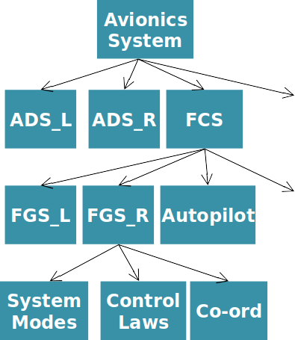
Hierarchical Reasoning
Avionic System Requirement:
Under single-fault assumption, GC output transient response is bounded in time and magnitude
Relies on:
Accuracy of air data sensors
Control commands from FCS
Mode of FGS
FGS control law behavior
Failover behavior between FGS systems
….
Response of Actuators
Timing/Lag/Latency of Communications

Slide 76
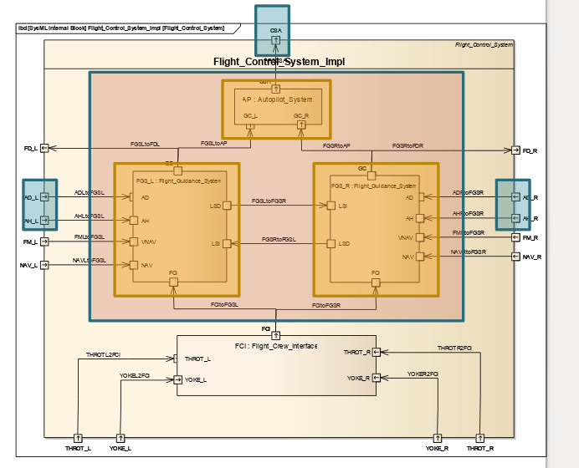
Compositional Reasoning for Active Standby
Want to prove a transient response property:
The autopilot will not cause a sharp change in pitch of aircraft.
Even when one FGS fails and the other assumes control
Given assumptions about the environment:
The sensed aircraft pitch from the air data system is within some absolute bound and doesn’t change too quickly
The discrepancy in sensed pitch between left and right side sensors is bounded.
and guarantees provided by elements:
When a FGS is active, it will generate an acceptable pitch rate
As well as facts provided by pattern application
Leader selection: at least one FGS will always be active (modulo one “failover” step)
transient_response_1 : assert true ->
abs(CSA.CSA_Pitch_Delta) < CSA_MAX_PITCH_DELTA ;
transient_response_2 :
assert true -> abs(CSA.CSA_Pitch_Delta - prev(CSA.CSA_Pitch_Delta, 0.0)) < CSA_MAX_PITCH_DELTA_STEP ;

Slide 77
Contracts
AGREE annotates AADL elements with:
Assumptions that elements make about the environment (input).
Guarantees that elements make about their output.
… As long as the assumptions are met.
Each layer of the hierarchy is verified individually.
AGREE attempts to prove the system-level guarantees in terms of the guarantees of its elements.
Notes:
Components and their connections are specified using AADL and annotated with assumptions that components make about the environment and guarantees that the components will make about their outputs if the assumptions are met. Each layer of the system hierarchy is verified individually; AGREE attempts to prove the system-level guarantees in terms of the guarantees of its components.

Slide 78
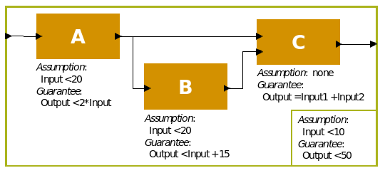
Contracts
Want to show that the system-level property holds, given the guarantees provided by the elements and the system assumption.
System-Level:
assume "System input range" : Input < 10;
guarantee "System output range" : Output < 50;
A
assume "A input range" : Input < 20;
guarantee "A output range" : Output < 2*Input;
B
assume "B input range":Input < 20;
guarantee "B output range" : Output < Input + 15;
C
guarantee "C output range": Output = Input1 + Input2;
Notes:
Suppose we have a simple architecture with three subcomponents A, B, and C - our toy example again.
In the model, we want to show that the system level property (Output < 50) holds, given the guarantees provided by the components and the system assumption (Input < 10). This toy example has one interesting feature: the property is true if all of the signals have type integer and it is false if they have floating point types (can you see why?).
The string "System input domain" is used to identify the assumption when performing verification. The expression Input < 10 expresses the condition that is assumed to hold. When verifying a component implementation, the component’s assumptions are assumed to be true. However, the assumptions of the component implementation’s subcomponents must be proved to hold based on the assumptions of the component and the guarantees of other subcomponents.
The string "System output range" is used to identify the guarantee when performing verification. The expression Output < 50 expresses the condition that is guaranteed to hold. When verifying a component implementation, guarantee statements are proven by the component assumptions and the guarantees present in subcomponent contracts.

Slide 79
AGREE Language Basics
Data types: integer, float, boolean
Integers can be 8-64 bit, signed or unsigned.
Float can be 32 or 64 bit.
Variables can include AADL data classes.
Alarm offers Boolean Is_Audio_Disabled, integer Log_Message_ID
Alarm.Is_Audio_Disabled => Alarm.Log_Message_ID > 3;
prev(x) uses the value of x from the last computational cycle.

Slide 80
AGREE Language Basics
Equation statements create local variable declarations.
eq ctr : int = prev(ctr + 1, 0);
Variable that counts up from 0.
“Intermediate” expressions that prove guarantees.
Properties allow specification of named Boolean expressions.
property not_system_start_implies_mode_0 = not(OP_CMD_IN.System_Start) > (GPCA_SW_OUT.Current_System_Mode = 0);
Constants can be defined:
const ADS_MAX_PITCH_DELTA: real = 1.0 ;
Notes:
1-2
In this example, we create a variable that counts up from zero. Variables defined with equation statements can be thought of as ''intermediate'' variables or variables that are not meant to be visible in the architectural model (unlike component outputs or inputs). Equation statements can define variables explicitly by setting the equation equal to an expression immediately after it is defined. Equation statements can also define variables implicitly by not setting them equal to anything, but constraining them with assumption, assertion, or guarantee statements. Equation statements can define more than one variable at once by writing them in a comma delimited list.

Slide 81
Go over Toy Example
Execute AGREE
Examine Counterexample
Fix Model
Notes:
If still time, look at GPCA

Slide 82
Key Points
Real-Time Systems have strict timing requirements, and tend to react to and influence an environment.
Architecting them is difficult and requires careful task scheduling.
Architectural Description Languages often have constructs for analyzing combinations of hardware and software with timing constraints.
AADL/AGREE designed for this purpose!

Slide 83
Next Time
Service-Oriented Architecture
Homework:
Reading Assignment 3 - Tonight!
Project, Part 4 - 12/06
Assignment 3 - 12/09

